Slide 1
DH 302 MIDSEM PROJECT
Chirag, 18B090003
BS Mathematics , IDDDP Healthcare Informatics
Ameya, 19B090002
BS Mathematics

Slide 2
CARDIOVASCULAR DISEASE
Cardi(o) – pertaining to the heart
Vascular – pertaining to arteries, veins,etc

Slide 3
Why study cardiovascular disease?
Cardiovascular disease is one of the most severe chronic diseases and is the leading cause of death and disability in the world.
Chronic diseases are defined as conditions that last for 1 year or more and require ongoing medical attention or limit activities of daily living or both – other types are diabetes, alzheimers, cancer, obesity, etc.
17.9 million people die due to cardiovascular diseases each year.
Heart disease costs the United States about $219 billion each year. (This includes the cost of health care services, medicines, and lost productivity due to death)

Slide 4
TYPES Broad types: Cerebrovascular disease(stroke) Coronary artery disease Congestive heart failure Ischemic heart disease, Other diseases of the heart MAY BE Genetically predisposed, Environmentally acquired

Slide 5
ARRYTHMIAS (Abnormal Heart Rhythms)
Causes:
Stress or anxiety
High blood pressure
Excessive use of alcohol (relaxant) or caffeine (stimulator)
Substance use
Side effect of some medication for ex. HCQS

Slide 6
CORONARY ARTERY DISEASE
Leading cause of heart attacks – myocardial infarctions.
Occurs when plaque builds up in the arteries, narrowing it and limiting blood flow to the heart. Without blood, tissue loses oxygen and dies.
Causes:
High blood pressure
Eating food high in cholesterol
Smoking
Lack of regular exercise
Diabetes

Slide 7
CONGESTIVE HEART FAILURE
Heart is unable to pump adequate amount of blood throughout the body.
Causes:
Obesity , high cholesterol level, high blood pressure
Unhealthy (high salt) diet
Stress
Certain medications like the syrup of Ipecac which is myotoxic used by people with eating disorders
Treatment: Adding a pacemaker (generates electrical impulses delivered by electrodes to cause the heart muscle chambers to contract and therefore pump blood

Slide 8
CEREBROVASCULAR DISEASE/STROKE
Damage to the brain from interruption of its blood supply, which causes brain cells to die. Ischemic stroke and Haemorrhagic stroke
Symptoms of stroke include trouble walking, speaking and understanding, as well as paralysis or numbness of the face, arm or leg.
Causes
Fatty deposits clog the brain’s blood vessels because of high cholesterol
Rupture in a blood vessel / blood clot / embolism

Slide 9
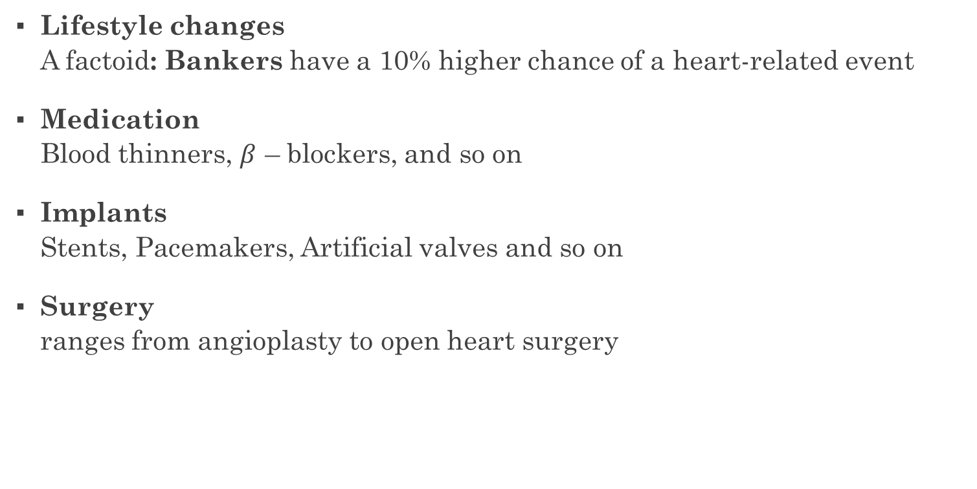
TREATMENT FOR HEART DISEASE:
Lifestyle changes A factoid: Bankers have a 10% higher chance of a heart-related event
Medication Blood thinners, $β$ – blockers, and so on
Implants Stents, Pacemakers, Artificial valves and so on
Surgery ranges from angioplasty to open heart surgery

Slide 10
RISKS
Family history
Race / Ethnicity
South Asians are more likely to develop coronary heart disease than white Europeans.
African or African Caribbean people are at higher risk of developing high blood pressure and having a stroke than other ethnic groups.
In the US, highest risk for obesity and death from heart diseases is seen in black people, followed by non-Hispanic whites.
Men are at greater risk for heart disease than women. According to the CDC, 70-89% of all cardiac events in the United States occur in men.

Slide 11
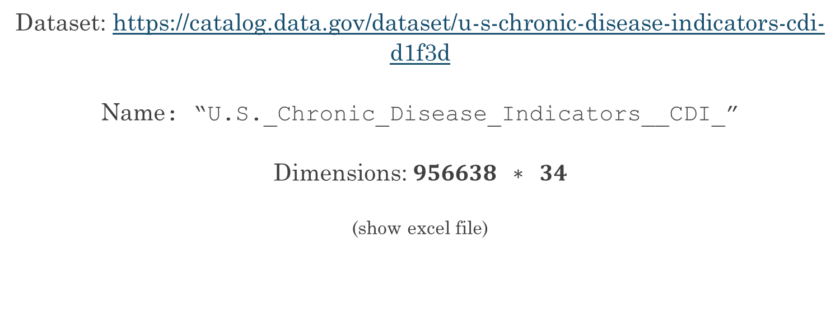
WELCOME TO THE REAL WORLD
Dataset: https://catalog.data.gov/dataset/u-s-chronic-disease-indicators-cdi-d1f3d
Name: “U.S._Chronic_Disease_Indicators__CDI_”
Dimensions: $956638 ∗ 34$
(show excel file)

Slide 12
About the data set
In this crude data set, unorganised “facts” or “data” have been presented about all health related records. We will try to extract information about four conditions:
Coronary artery disease
Congestive heart failure
Cerebro-vascular disease (Stroke)
Other Diseases of the heart

Slide 13
Questions
How common is cholesterol screening among adults (18+) in these states? And what is the high cholesterol prevalence in these states?
What is the prevalence of high blood pressure (hypertension) in the adult population in USA?
What is the hospitalization rate for stroke and acute myocardial infarction?
Can these questions be answered just by looking at the data set? No. That’s where the computer comes in.

Slide 14
Elephant in the room
Race-wise and Gender-wise mortality rates due to the above 4 mentioned conditions as a measure out of 100,000 population:
Which race has a higher mortality rate due to the above 4 diseases?
What is the SMR( Standardized mortality ratio) in the case of each race, when compared to the overall population?
How does the mortality look like when we compare men and women?

Slide 15
To address the elephant
We will consider the following races.
White
Black
Asian
Latin/Hispanic
Asia/Pacific
In the states of
California, New York
And USA as a hole

Slide 16
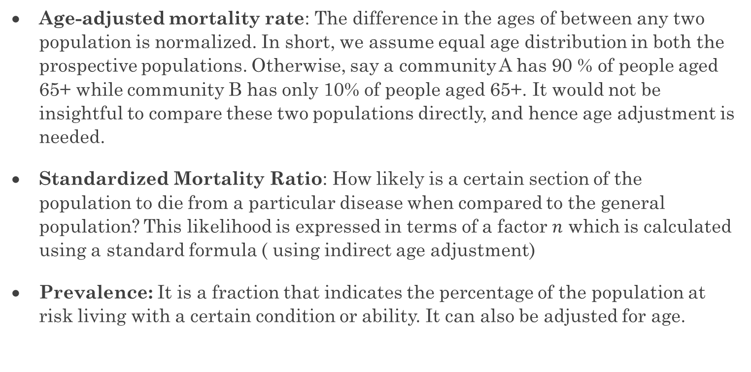
A few definitions
Age-adjusted mortality rate: The difference in the ages of between any two population is normalized. In short, we assume equal age distribution in both the prospective populations. Otherwise, say a community A has 90 % of people aged 65+ while community B has only 10% of people aged 65+. It would not be insightful to compare these two populations directly, and hence age adjustment is needed.
Standardized Mortality Ratio: How likely is a certain section of the population to die from a particular disease when compared to the general population? This likelihood is expressed in terms of a factor $n$ which is calculated using a standard formula ( using indirect age adjustment)
Prevalence: It is a fraction that indicates the percentage of the population at risk living with a certain condition or ability. It can also be adjusted for age.

Slide 17
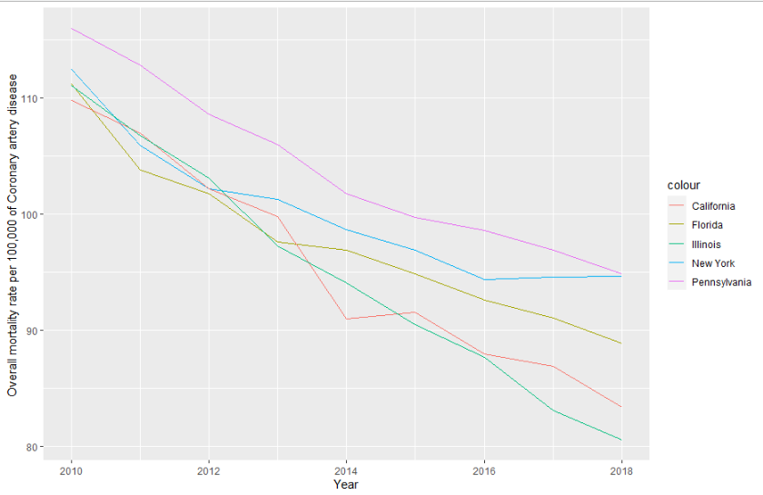
Coronary artery disease- Mortality in 5 states

Slide 18
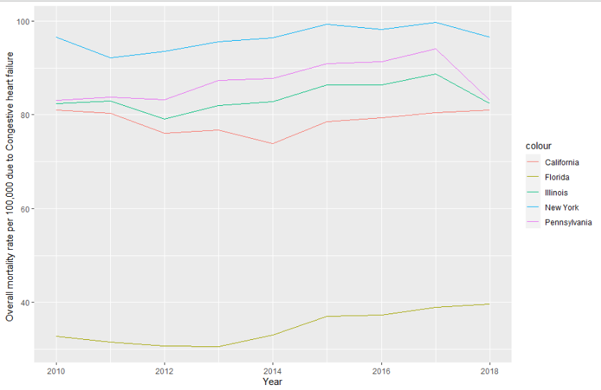
Congestive heart failure - Mortality in 5 states

Slide 19
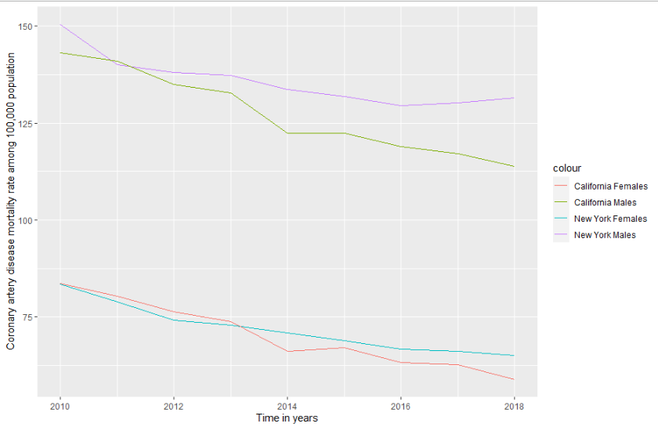
MALE and FEMALE counterparts in two states Coronary artery disease

Slide 20
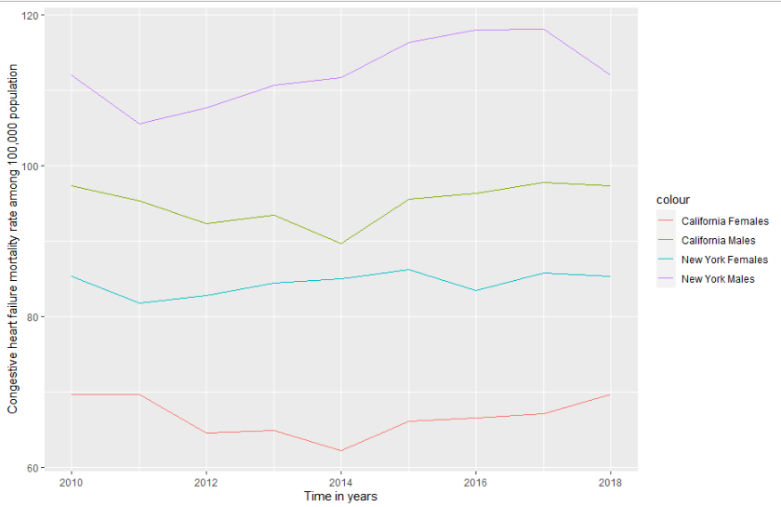
MALE and FEMALE counterparts in two states Congestive heart failure

Slide 21
Why do men have a higher risk of dying?
Is it because they live dangerously? Maybe. Probably not.
We will try to see why in the few forthcoming slides.

Slide 22
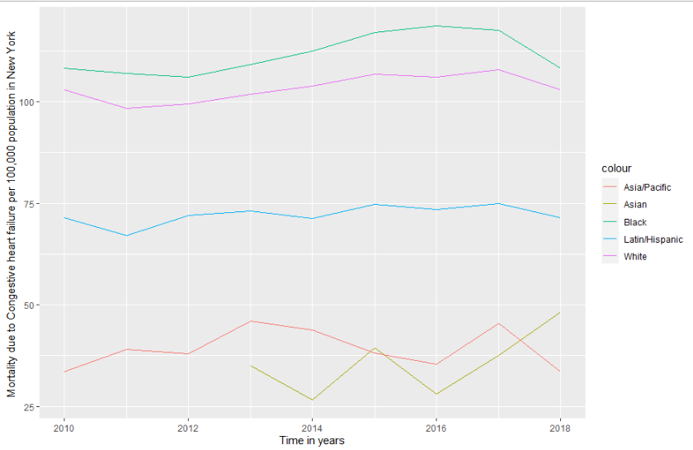
RACEWISE MORTALITY DUE TO CHF New York

Slide 23
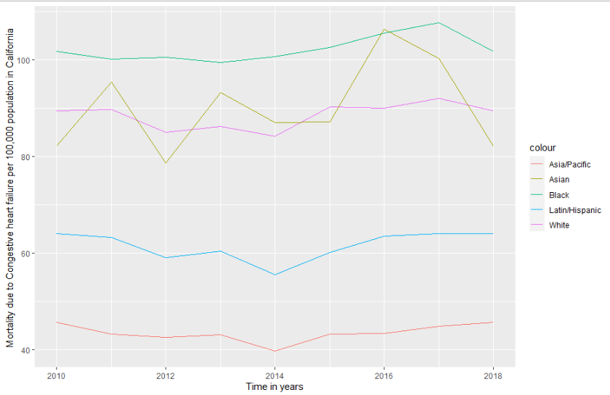
RACEWISE MORTALITY DUE TO CHF California

Slide 24
Who wins? (inappropriate framing)
Indians have been included in the category of Asians, and American-Indians have been shown to be much more at risk for heart failure when compared to the white population.
However, the black population take the #1 spot at risk for all kinds of heart diseases.

Slide 25
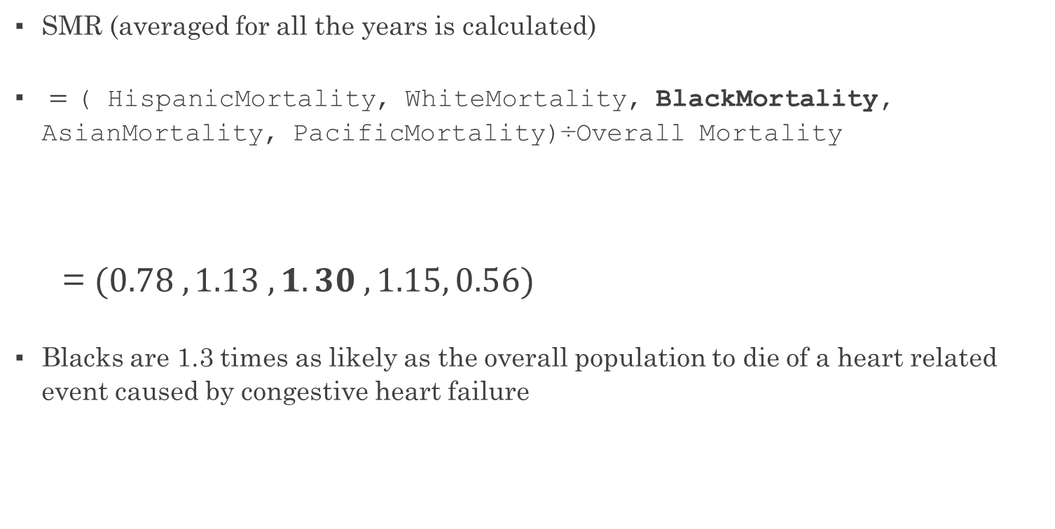
Racewise SMR of Congestive heart failure
SMR (averaged for all the years is calculated)
$=$ ( HispanicMortality, WhiteMortality, BlackMortality, AsianMortality, PacificMortality)÷Overall Mortality
= $(0.78 , 1.13 , 1.30 , 1.15, 0.56)$
Blacks are 1.3 times as likely as the overall population to die of a heart related event caused by congestive heart failure

Slide 26
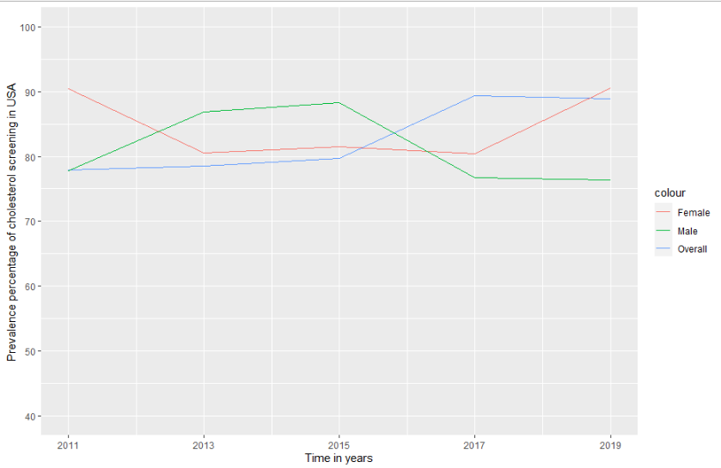
Q1: How common is cholesterol screening among adults (18+)? And what is the high cholesterol prevalence ?
CHOLESTEROL
SCREENING
PREVALENCE

Slide 27
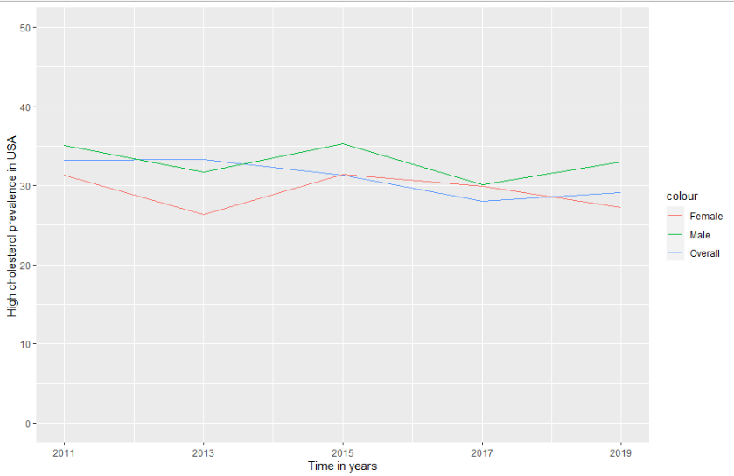

High cholesterol prevalence = $\frac{The number of people at risk screened positive for high cholesterol}{Total number of people at risk screened}$
HIGH CHOLESTEROL
PREVALENCE
AMONG THOSE TESTED

Slide 28
Inferences
A much higher percentage of the male population could be living with high cholesterol without getting screened.
Male population > Female population Therefore, higher crude numbers of males being possibly killed by heart-related events

Slide 29
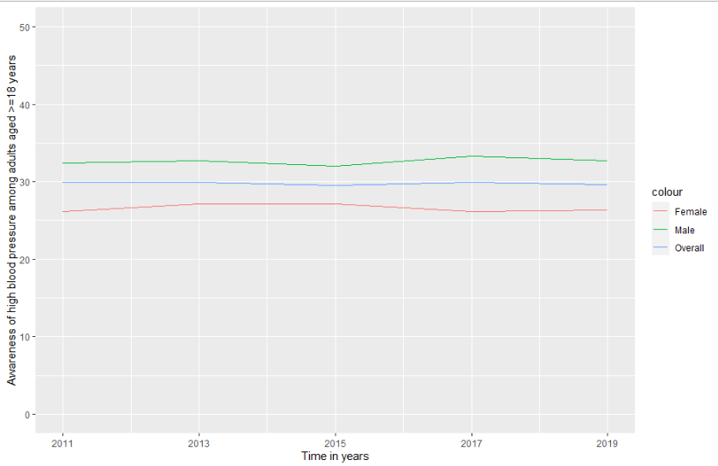
Q2: What is the prevalence of high blood pressure (hypertension) in the adult population in USA?

Slide 30
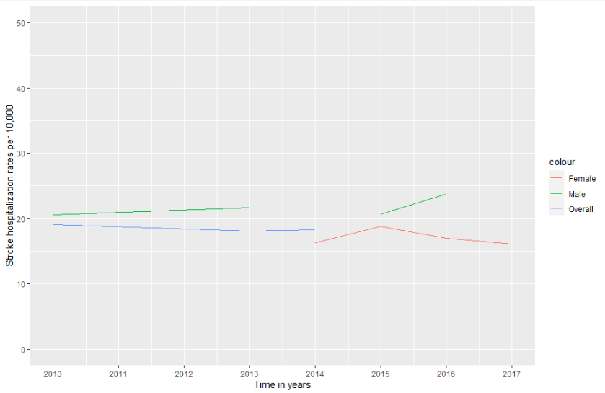
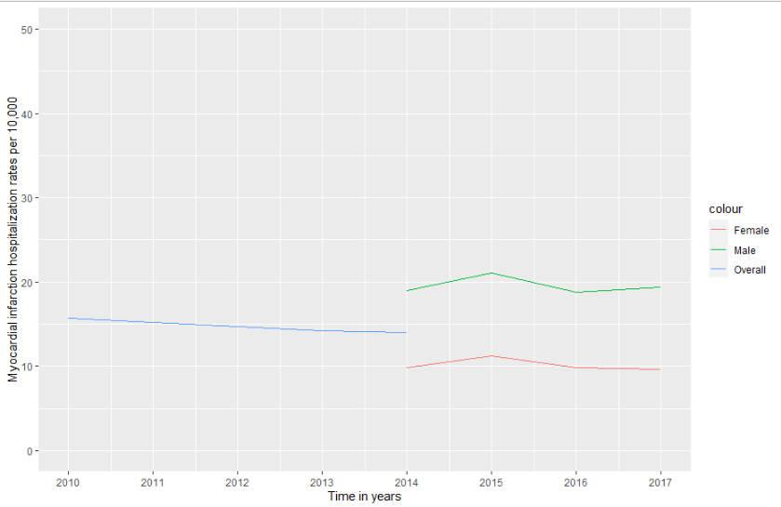
Q3: What is the hospitalization rate for stroke and acute myocardial infarction?
STROKE
MYOCARDIAL INFARCTION

Slide 31
How it was done
methods:
All coding and analysis in R, codes attached here: (we varied one variable to get answers for the rest)
Code has been attached in a separate .txt file

Slide 32
Noteworthy points
The alpha numeric coding of the US states aided us a lot to create time series for all the states of mortality due to all the four conditions
The coding of the categories as: : {“OVR" "GENF" "GENM" "HIS" "WHT" "BLK" "AIAN" "API" } helped us analyze the data easier by making accessibility better
There were a lot of “NA” values which led me to restrict the data sets significantly, and there were still further “NA”s in the hospitalization due to stroke and MI.

Slide 33
What I could salvage
Created a large list of 11 elements each corresponding to one year from 2010 to 2020 of ONLY data related to cardiovascular disease
Each list was a large matrix containing 27 types of data entries, including crude rates, age adjusted rates, raw numbers, immunizations, hospitalization rates, prevalence rates etc
This can be done similarly for all the states, and for all conditions. I have only considered the Age adjusted rates to eliminated the differences in the age compositions of the states, and therefore is the more accurate measure when compared to crude rates.

Slide 34
In retrospect
Need to mitigate creeping up rates of cardiovascular diseases
Awareness of better diet options, frequent screening, more accessible health centres with advanced equipment, and natural primary prevention measures like exercising, reducing salt intake should be popularized
Studies have shown that Indians are more susceptible to cardiovascular disease than Caucasians, who are the main topic of this analysis
So, it becomes all the more important for India to step up cardiovascular care facilities, and along with that, better information systems and management

Slide 35
In hindsight
We had to consider a US dataset due to the unavailability of an Indian dataset
India should start making it’s hospital data more transparent by developing newer E-H-R standards and phasing out the outdated
While doing so, a standard format (like the aforementioned for alphanumeric coding, coding of categories) should be framed so that the data because readily accessible

Slide 36
Looking forward
Plan to analyse state-wise cancer statistics which is a huge subset of the already big data and try to compare cancer prevalence rates and mortality rates of different states.
We will also consider the geographical aspect (using the GPS location given in the data) and try to apply a primitive learning algorithm to determine the “clustering areas” of high cancer rates , and will try to draw insights and explain them.

Slide 37
BIBLIOGRAPHY
https://catalog.data.gov/dataset/u-s-chronic-disease-indicators-cdi-d1f3d
https://www.apollohospitals.com/
https://www.who.int/health-topics/cardiovascular-diseases
https://www.nhs.uk/conditions/coronary-heart-disease
https://www.cdc.gov/heartdisease/facts.htm
https://www.healthline.com/health/heart-disease

Slide 38

Welcome to the final slide. Please go back or go to the next presentation

Slide 39
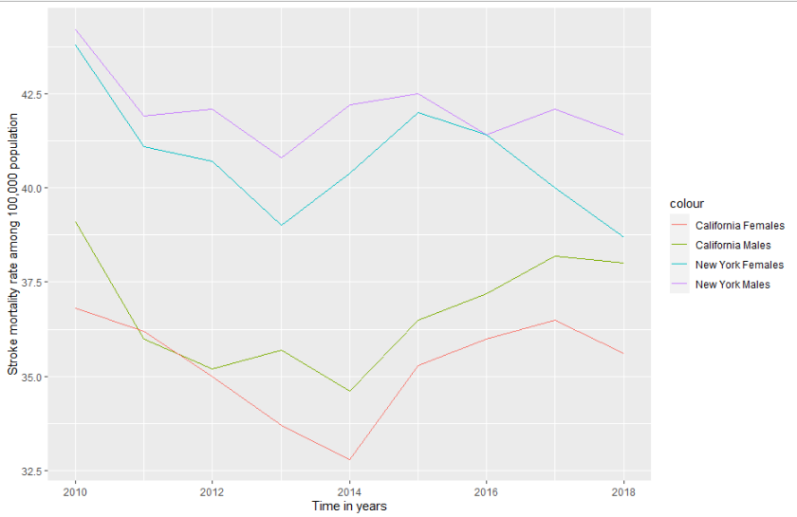
ANOMALY IN STROKE / NEW YORK

